Slide 1


Welcome
The Woodlands College Park High School is dedicated to student learning in a safe, positive environment where a community partnership enhances self-esteem, encourages mutual respect and develops life-long learners and productive citizens.

Slide 2
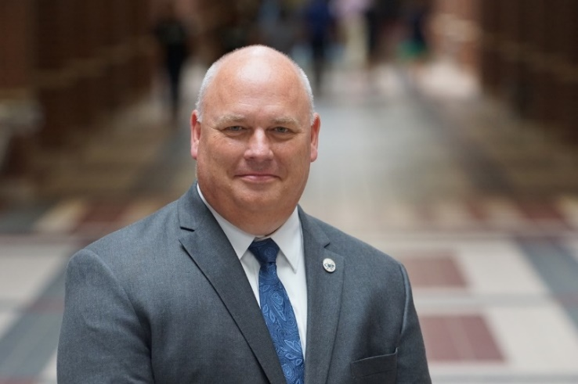
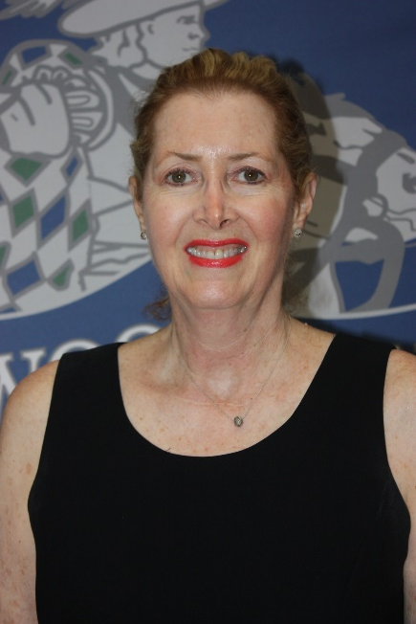
Administration
Dr. Mark A. Murrell
Principal
Dr. Susan Caffery
Headmaster
Academy of Science and Technology

Slide 3
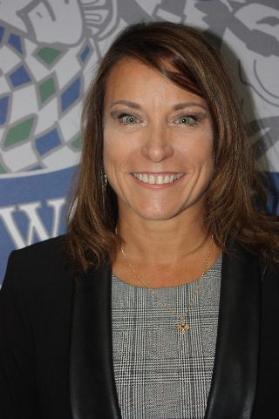
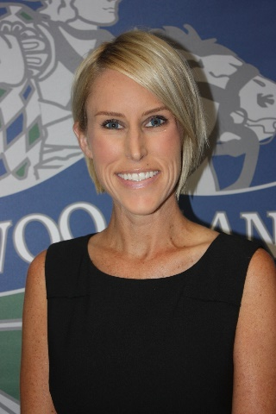
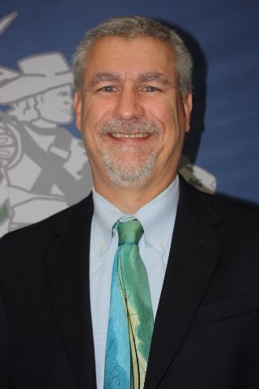
Associate Principals
Dr. Sue Hersperger
Curriculum and Instruction
Ms. Melanie McCarthy
Operations
Mr. Clint Holden
Administration

Slide 4
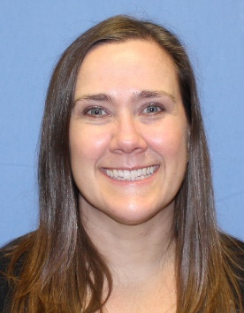
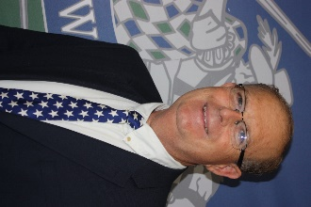
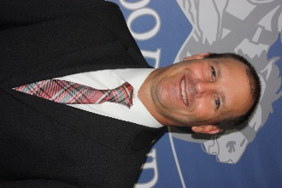
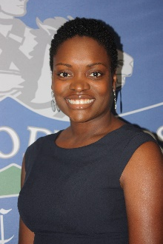
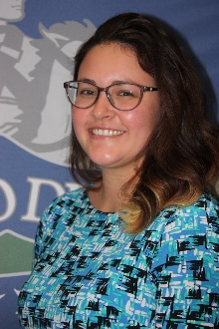

Assistant Principals
Mr. Danny Johnson
A-Clb
Mr. Lee Koslosky
Clc - Gomz
Mrs. Julie Roth
Gon - Leez
Mrs. Victoria Brinkman
Lef - Pam
Mrs. Kelsey Meredith
Pan - Slv
Ms. Ashley Wallace
Slw-Z

Slide 5
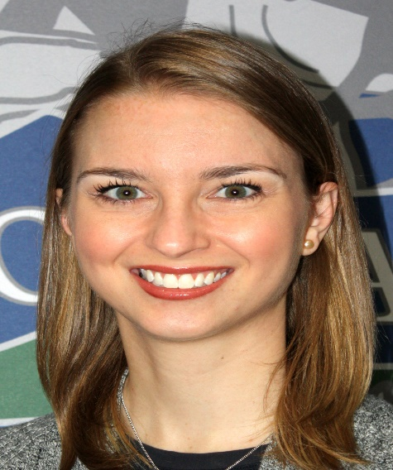
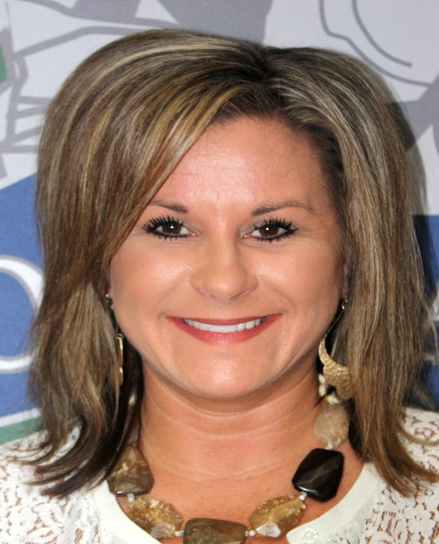
9th Grade Counselors
Meagan Piatkowski
9th Grade Counselor for students A-LEE
Shannon Andersen
9th Grade Counselor for students LEF-Z

Slide 6
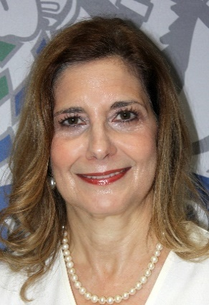
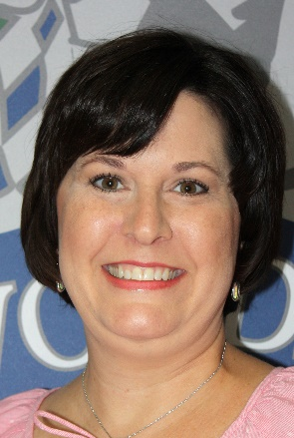
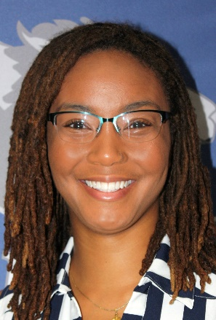
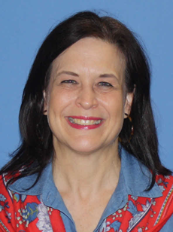
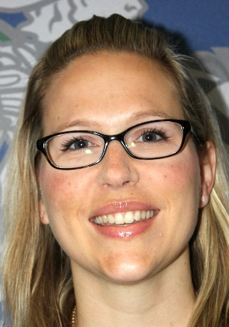
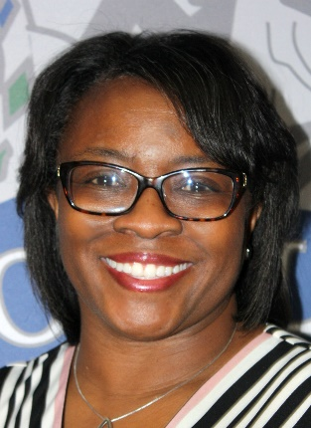
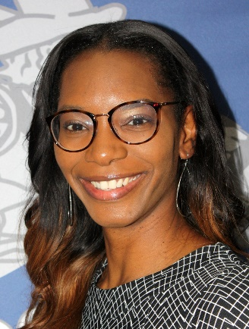
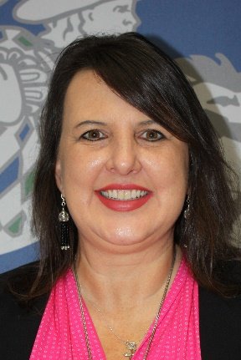
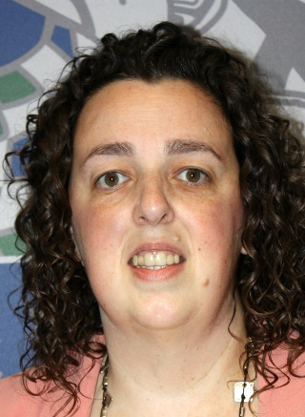
Alpha Counselors 10th-12th Grade
Christina Flores
Lead Counselor
Cindy Doud
A-CASP
Dion Henry
CASQ-FIL
Mary Lou Florian
FIM-H
Mary Edgerly
I-MAS
Chiante Deal
MAT-PRE
Jaime Slabaugh
PRF-STEP
Tammy Morrow
STBQ-Z
Debra Creel
College & Career

Slide 7

Course Registration
To gear up for the future, a student must make wise course selections.

Slide 8
The 4 Year Plan
Is both a 4 year comprehensive plan and a yearly registration tool for course selection.
Comprehensive Plan
Credits
  Junior High
  Required
  Yearly Earned
Endorsements
Course Selection
On Line Registration
Yearly
Advisement

Slide 9
On Line Registration
Course selections for next year are completed through the 4-Year Plan.
  Year 1 = 9th Grade
  Year 2 = 10th Grade
  Year 3 = 11th Grade
  Year 4 = 12th Grade
Your student’s four year plan has been reopened for revising until February 7th. You and your student will be able to edit until that deadline.
Registration will close on February 7th. Any changes after this deadline will need to go through the high school counselors.

Slide 10

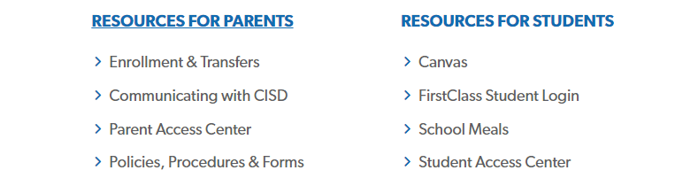
How to get to the 4 year plan

Slide 11

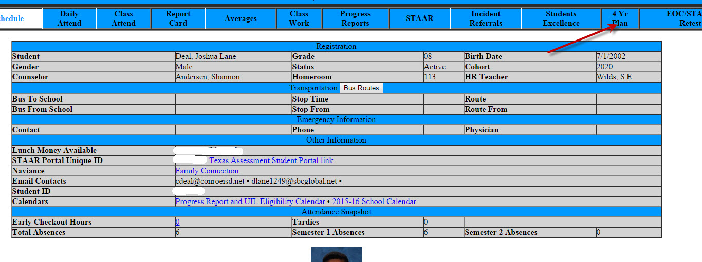
How to get to the four year plan

Slide 12
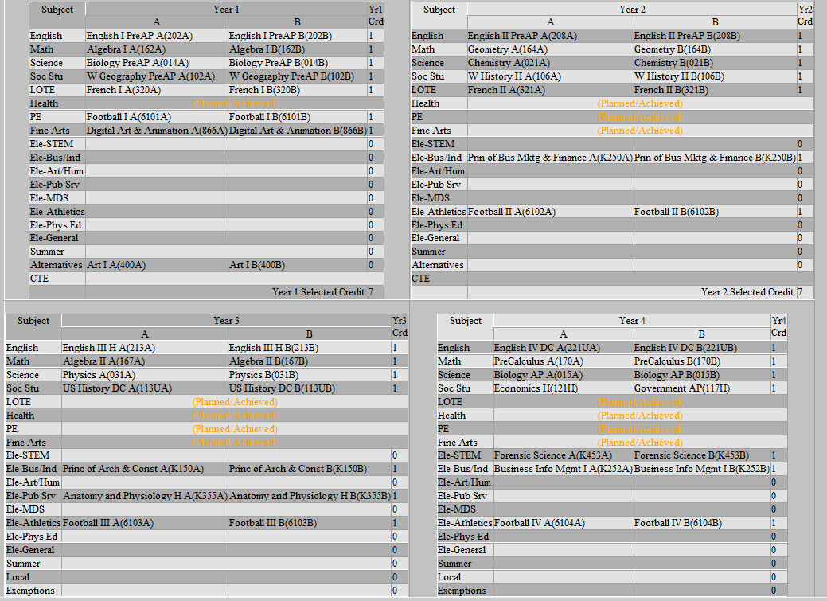
Four Year Plan

Slide 13
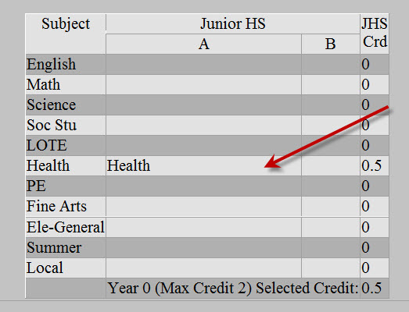
Junior High Credit
Notes:
Remind students that some of them may have high school credit from junior high.

Slide 14
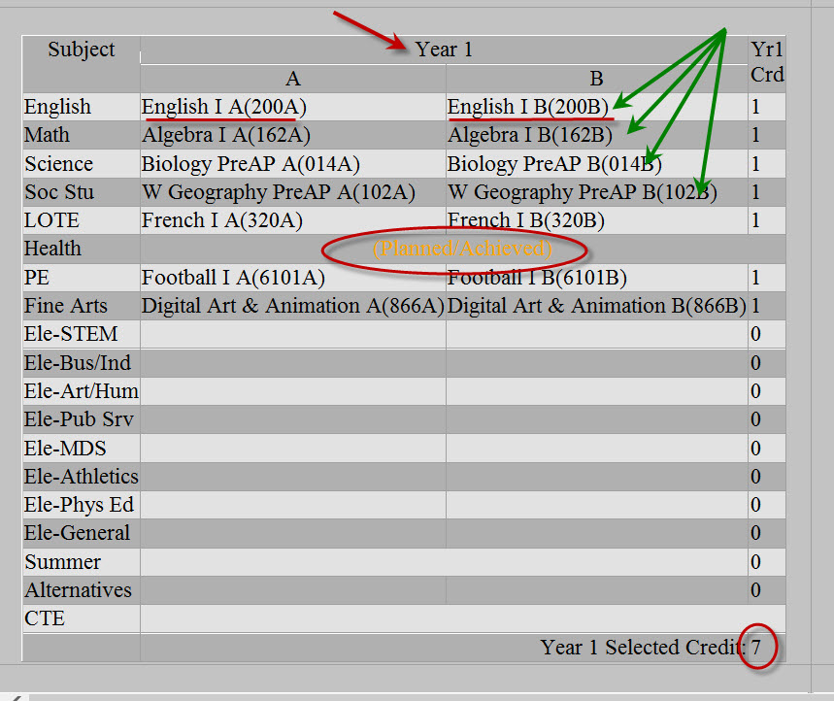
Notes:
Things to point out:
Year 1
Must have fall and spring AND must match when it is a year long class. Not Eng 1 and Eng 1 PreAP
Must have 4 cores
What does Planned Achieved mean
Total number of credits must equal 7

Slide 15
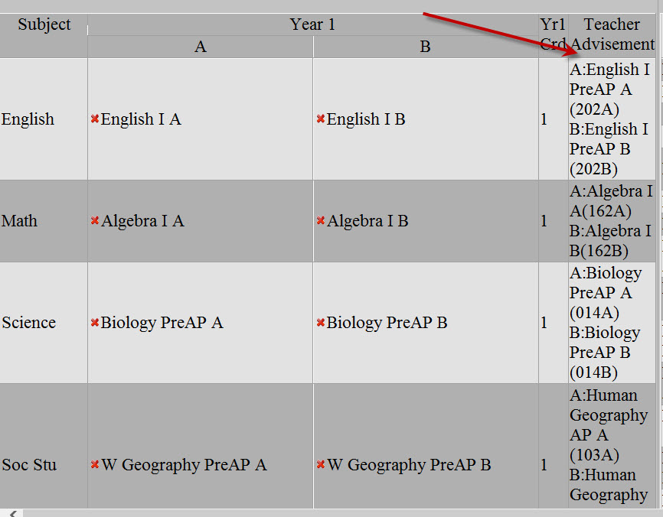
Teacher Advisement
Notes:
Talk about advisements

Slide 16
Why are Teacher Advisements Important?
The teacher has the biggest piece of the puzzle for students.
The teacher knows the student as well as the curriculum expectations.
The counselor knows the academic performance of the student.
The parent knows the student involvement outside of school.

Slide 17
Course Sequence Options
Conroe ISD Program of Studies
(CISD home page – under Parents/Students – Policies, Handbooks & Forms)
  Course sequence for core classes
  Prerequisites for courses

Slide 18
Honors vs. AP
Honors generally means that it is a course helping the student to prepare for the AP course later. It is more rigorous than a level course.
AP means it is considered college level work. The student takes an AP exam in May and may earn college credit if they score high enough. The college the student attends issues the credit.

Slide 19
What is the difference between:
Level / Honors / AP & Dual Credit courses?
Current Information (Policies are reviewed at the end of the year and may change)
Level Classes | Honors Classes | AP & Dual Credit Classes
Major Grades: 70% Daily Grades: 30% | Major Grades: 75% Daily Grades: 25% | Major Grades: 80% Daily Grades: 20%
Teachers tend to provide more direct instruction. | Teachers provide some direct instruction, while at the same time introducing crucial skills and concepts to prepare the students to take on a more independent role needed for more challenging academic courses | Students are generally self-motivated. The teacher’s role is primarily as facilitator of learning.
Adhere to Texas Standards of Learning. | Adhere to Texas Standards of Learning; however, expectations go beyond these standards to prepare the students for more challenging academic courses. | Students are consistently held to standards of evaluation and achievement that go beyond what is expected from the Texas Standards of Learning. These standards are consistently enforced as a way to prepare students for the demands of a collegiate setting.
Retest Policy: 2 retest or a replacement 9 weeks cumulative exam | Retest Policy: 1 retest or a replacement 9 weeks cumulative exam | Retest Policy: No retest or replacement exam

Slide 20
Necessary Skills FOR Honors courses
SUCCESSFUL Honors students:
manage concurrent assignments
incorporate priority-setting
self-discipline during reading and writing assignments
take responsibility to be aware of assignments and to meet the due dates for these assignments
develop independence in learning

Slide 21
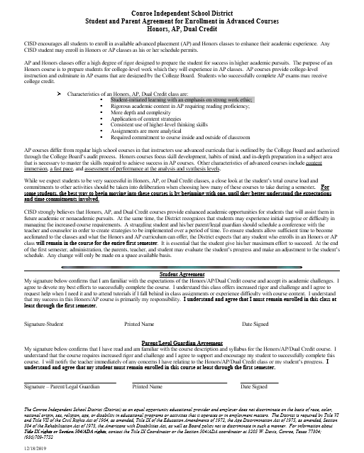
Advanced Course
Agreement Form
When registration closes, the Advanced Course Agreement will be emailed to you through your PAC account.
If Student and Parent do not sign the ACA, the student will be dropped from the advanced courses.
Notes:
After registraion closes, if you have signed up for an advanced class, you and your parents will receive an email requiring you to sign the Advanced Course Agreement. If you and your parent do not sign the agreement, you will be dropped from the Advanced course.

Slide 22
How does the level of a class impact GPA?
Student 1
Student 2

Slide 23
Choosing Electives
What are the student’s interests?
What is the student’s area of endorsement?
In the four year plan, electives are listed in the area of endorsement. (Students have a course sheet.)
Please refer to the Program of Studies for pre-requisites for courses.
Select at least 3 alternates – list by preference.

Slide 24
Spanish 2 vs. Spanish 2G
Spanish 2G is an accelerated Spanish class but is awarded the same grade points as Spanish 2 regular. The “G” stands for “going on.” It is recommended for students who plan to take Spanish 3 level or Spanish 3 Honors the following year.
Spanish 2G
Faster pace
More vocabulary and grammar objectives are covered
Tests and quizzes are more rigorous and challenging
Registration – pay close attention to the course number when you register for Spanish 2
Spanish 2 – 301 Spanish 2G – 301G

Slide 25
Language Placement Exam
Students who are fluent in a foreign language may test.
Test will be at Knox Junior High date and time TBD.
Sign up through current counselor.
Languages tested:
  Spanish
  French
  Chinese
  Japanese
  German

Slide 26
Off Campus PE
Student must select Off Campus PE in the 4 year plan
An email will be sent with directions for filling out the online application.
The online application must be completed in order for the student to be in off campus PE
Online Registration is March 16-May 1

Slide 27
Special Classes
Students wishing to participate in more than one sport should sign up for the sport occurring first in the school year.
Students will select Marching Band under PE unless also participating in some type of athletics.
Some classes require a tryout and cannot be chosen at this time.
Drill Team Cheerleading Color Guard Trainer

Slide 28
Course Selection Checklist
Select a total of 7 periods
Communicate with your student
(Both you and your student can change your course selections)
Consult with current teachers regarding advisement for next year
Electronically sign the Advanced Course Agreement form (if applicable)
Review course requirements and descriptions in the Program of Studies
List 3 alternates in case space availability is limited or a class does not make. (List both ½ credit and full credit alternates.)

Slide 29
How do I change my selected courses?
Delete the existing course by clicking on the red “X”
Why is a course not available in the four year plan?
Prerequisites
Inappropriate grade
Elsewhere in plan

Slide 30
How do I change my selected courses after registration has closed?
Incoming 9th Grade students should E-mail the high school counselor assigned to your student (see below).
Verification will be posted in PAC in March and April.
Meagan Piatkowski (A-Lee) – mepiatkowski@conroeisd.net
Shannon Andersen (Lef-Z) – sandersen@conroeisd.net

Slide 31
Counselors
Incoming 9th Grade Students and Current 9th Grade Students
Meagan Piatkowski (A-Lee) – mepiatkowski@conroeisd.net
Shannon Andersen (Lef-Z) – sandersen@conroeisd.net
10th and 11th Grade Students
A – CASPZ – Cindy Doud – cdoud@conroeisd.net
CASQ – FILZ – Dion Henry – dhenry@conroeisd.net
FIM – HZ – Mary Lou Florian – mflorian@conroeisd.net
I – MASZ – Chiante Deal – cdeal@conroeisd.net
MAT – PREZ – Mary Edgerly – medgerly@conroeisd.net
PRF – STEPZ – Jamie Slabaugh – jslabaugh@conroeisd.net
STEPQ – Z – Tammy Morrow – tmorrow@conroeisd.net

Slide 32
I applied to the Academy
Complete the four year plan as instructed
If accepted to the Academy, the student’s four year plan will be adjusted to the correct courses
More information will be available at Academy Registration Night

Slide 33
I am on a Transfer
Complete the four year plan as instructed for the school you are scheduled to attend.
Once the transfer is approved, your courses will be updated.

Slide 34
Remember. . . .
The four year plan is THE course registration for next year.
The courses in the plan for your designated year will be entered in the system as the student’s course selection.

Slide 35
Schedule Change Policy
Course selection determines master schedule.
Students will not be allowed to change level of a class except as noted on the Advanced Course Agreement.
Important!!

Slide 36
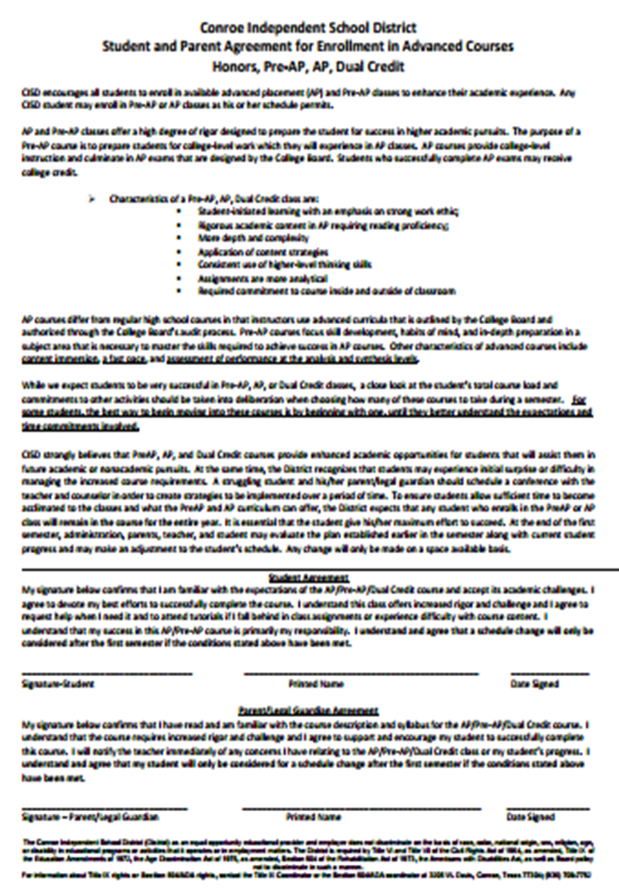
Advanced Course Agreement
A struggling student and his/her parent/legal guardian should schedule a conference with the teacher and counselor in order to create strategies to be implemented over a period of time.

Slide 37
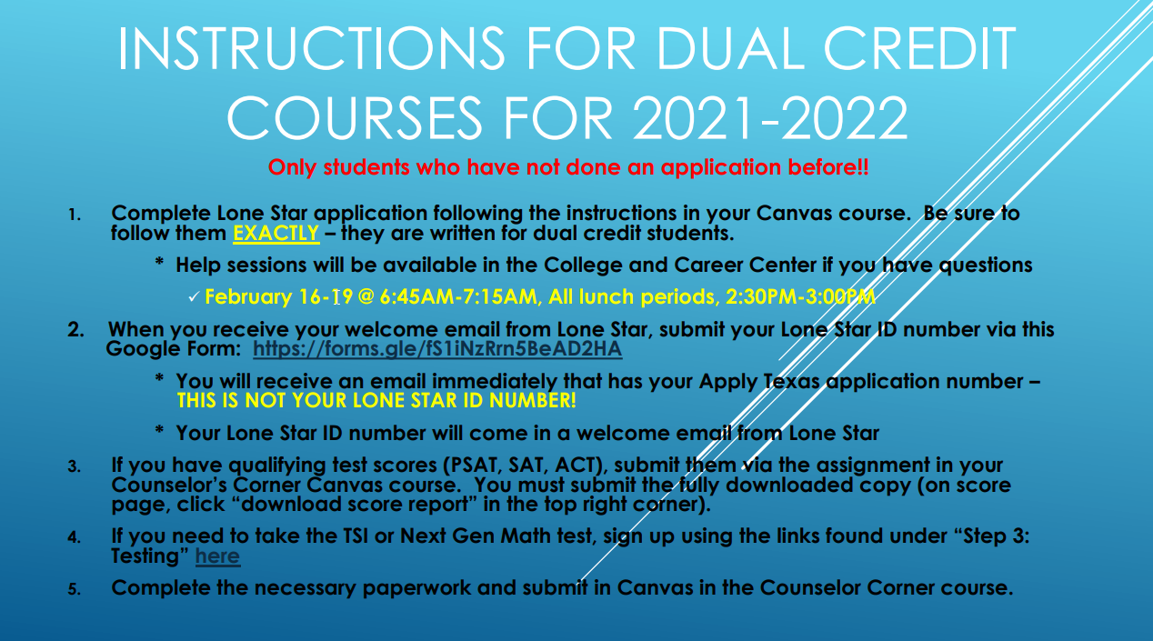
I would like to take a Dual Credit Course Next Year

Slide 38
College Park Counselor Resources
Program of Studies
Counselor names and email
CANVAS – Counselor Corner
  Student and parent presentations
  Student course sheet

Slide 39
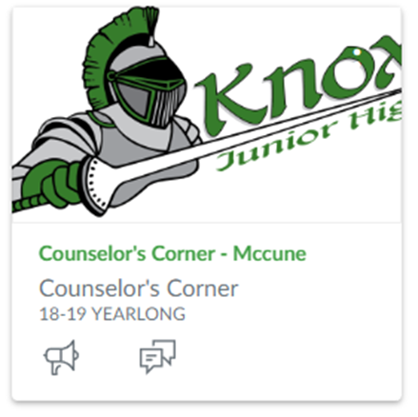
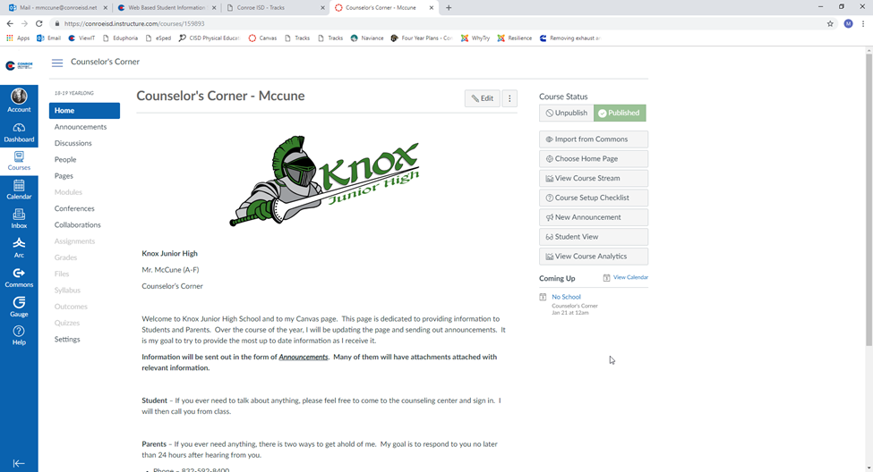
Canvas

Slide 40
Recap of Important Dates
Course Selection Night (Spanish) January 25th @6:30p.m. - VIRTUAL
College Park Showcase-
Thursday, February 4th @ 5:30
Course registration closes Sunday, February 7th
AST Registration Night Tuesday, February 23rd @ 6:00
Parent Information Nights for Incoming 9th Grade and Upperclassmen - TBD
All course request changes must be made by Friday, April 23rd

Slide 41
Orientation Dates
The following activities are held during the summer prior to school starting. The dates will be forthcoming.
9th Grade Orientation
Camp Cavalier
Upperclassmen and Open Orientation

Slide 42
Questions – Please email your child’s counselor:
Incoming 9th Grade Students and Current 9th Grade Students
Meagan Piatkowski (A-Lee) – mepiatkowski@conroeisd.net
Shannon Andersen (Lef-Z) – sandersen@conroeisd.net
10th and 11th Grade Students
A – CASPZ – Cindy Doud – cdoud@conroeisd.net
CASQ – FILZ – Dion Henry – dhenry@conroeisd.net
FIM – HZ – Mary Lou Florian – mflorian@conroeisd.net
I – MASZ – Chiante Deal – cdeal@conroeisd.net
MAT – PREZ – Mary Edgerly – medgerly@conroeisd.net
PRF – STEPZ – Jamie Slabaugh – jslabaugh@conroeisd.net
STEPQ – Z – Tammy Morrow – tmorrow@conroeisd.net

Slide 43

Thank you!
Go Cavaliers!

